Slide 1
Online Shopping Application

Slide 2
Services
User Module
Product Module
Cart Module
Order Module
Payment Module

Slide 3
Order Module
The Order Module is responsible for managing operations related to orders, such as order creation, updating, deletion, order retrieval, and status management.
It integrates with other services (e.g., inventory, payment, user management) and ensures that the necessary validations, security, and business rules are enforced.
It provides a clear separation between the database (Entity) and the data transferred across the system (DTO), ensuring maintainability and scalability.

Slide 4
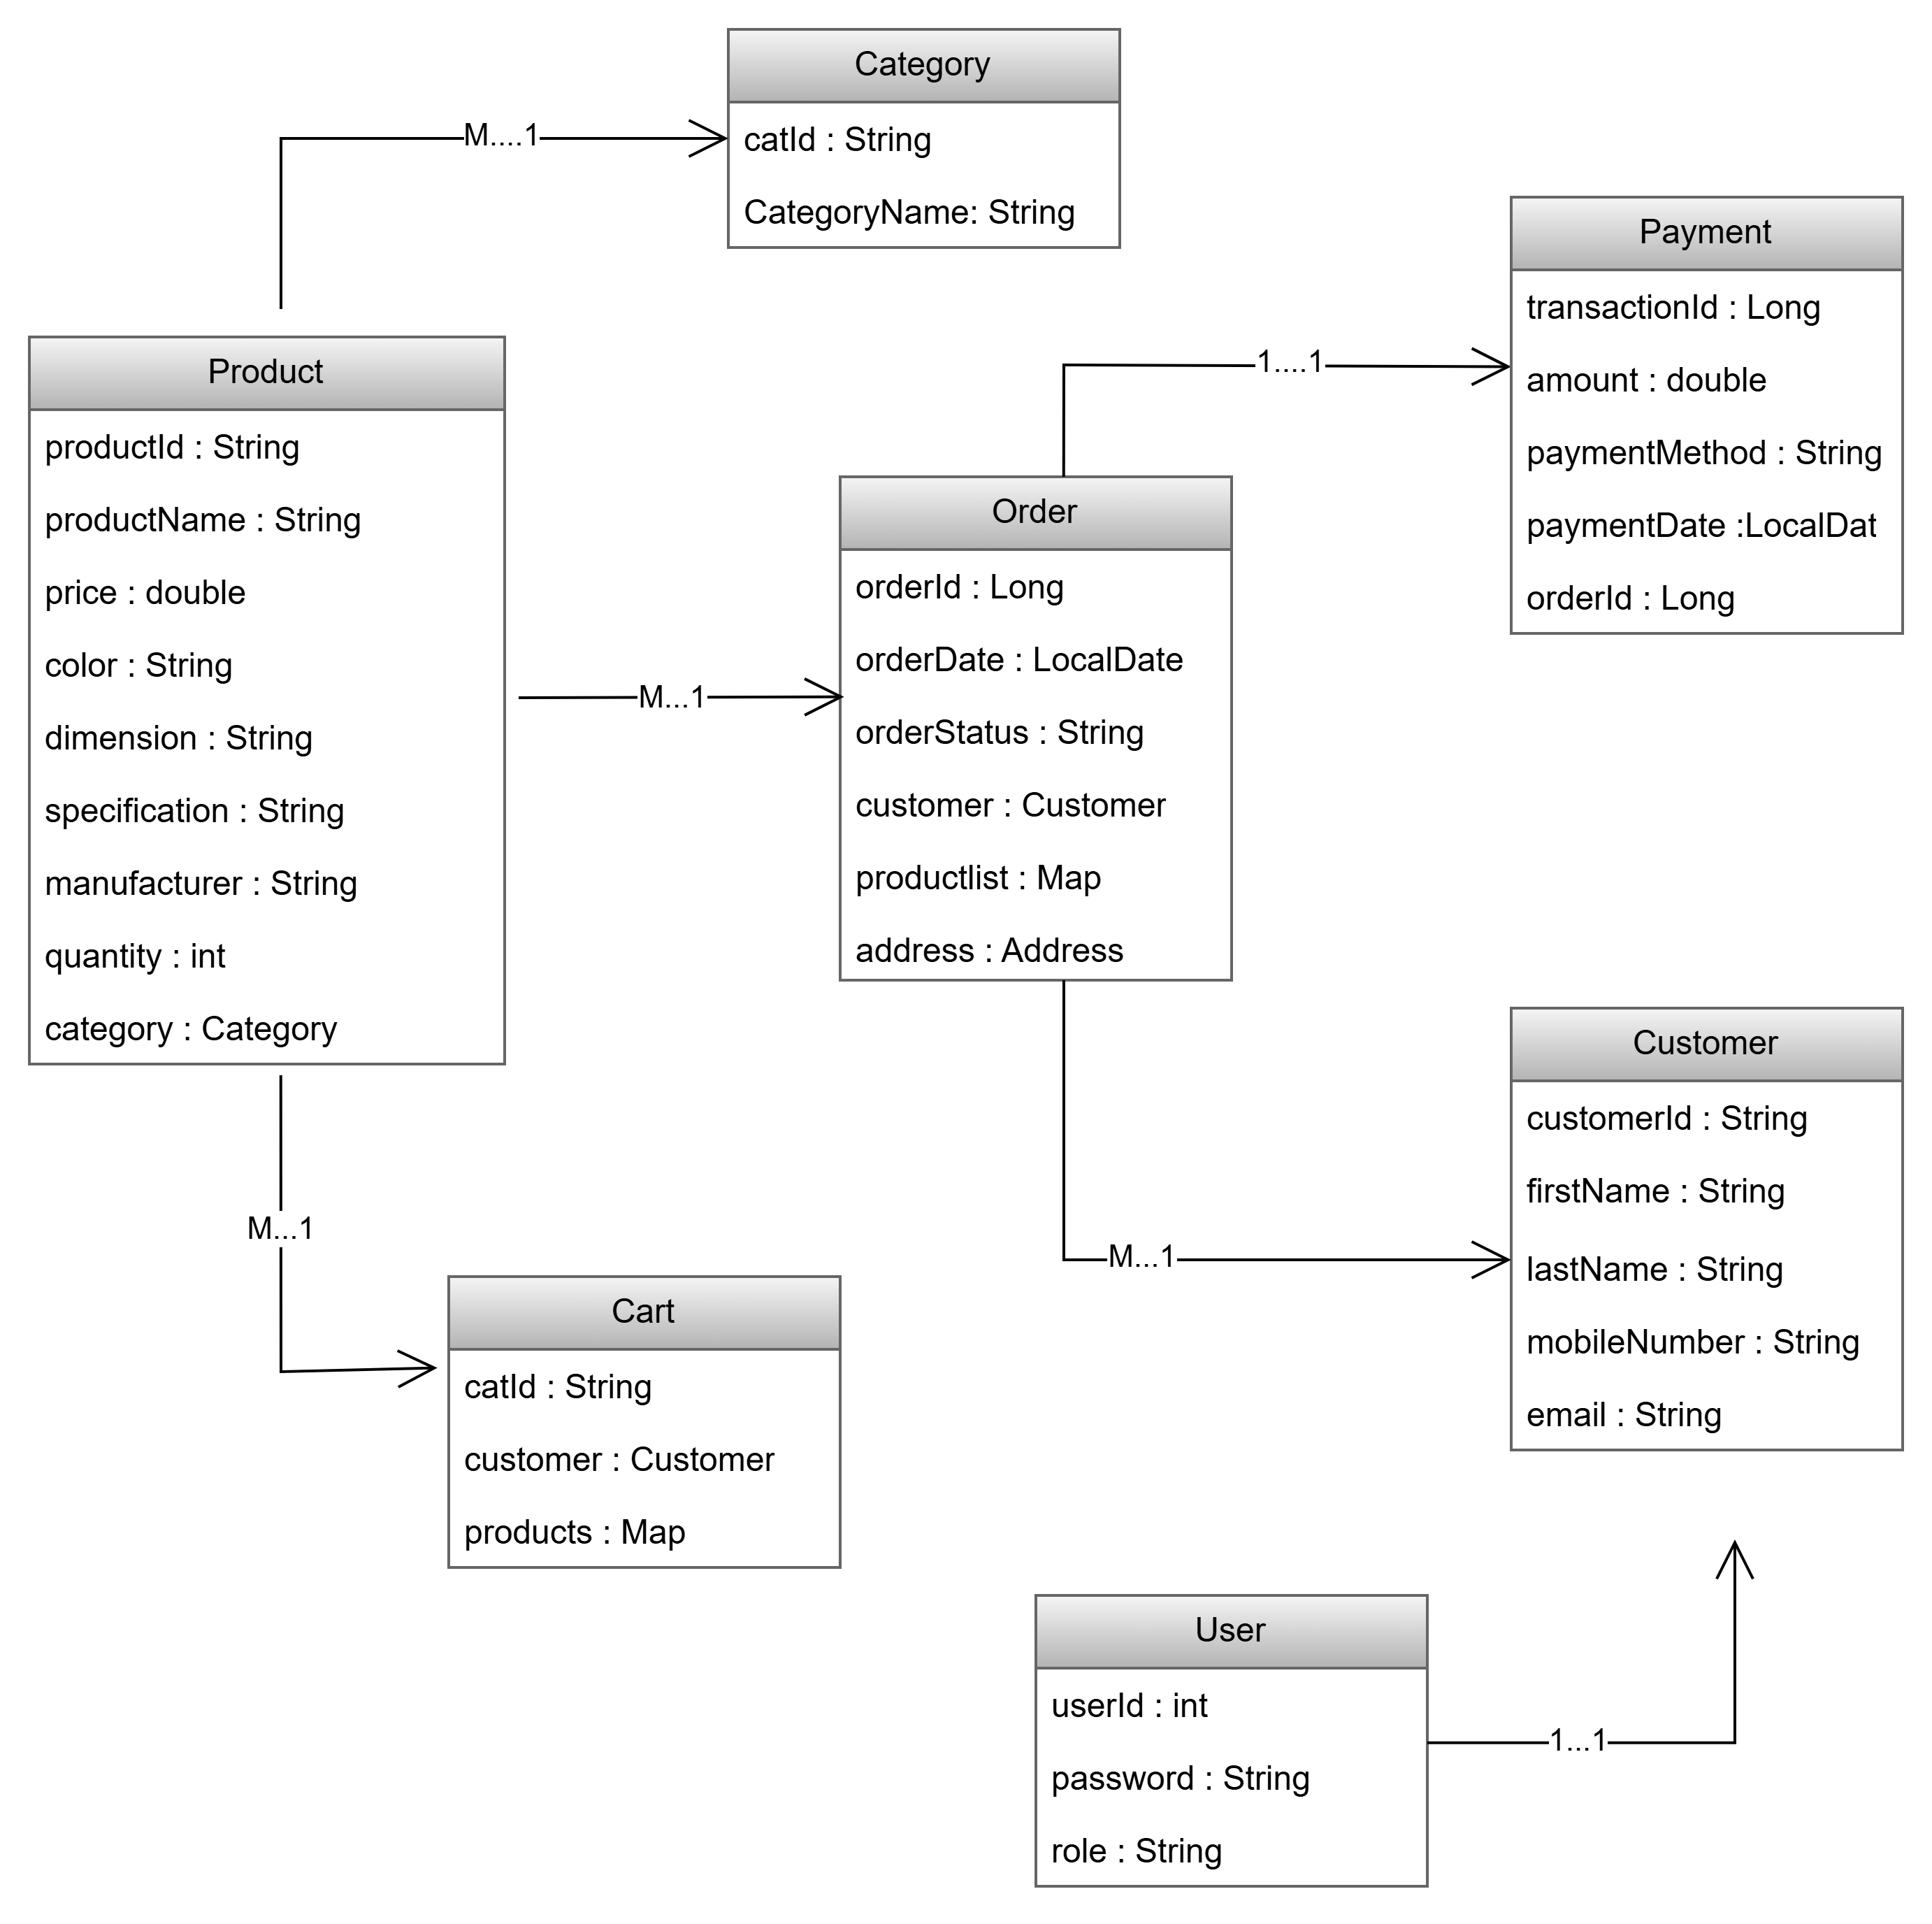
Entity-Relation Diagram

Slide 5
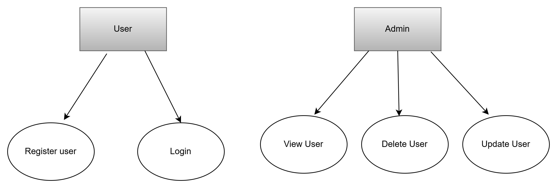
Use-Case Diagram

Slide 6
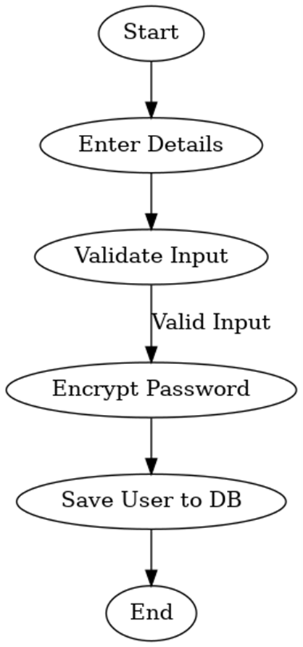
Activity Diagram

Slide 7
THANK YOU

